Slide 1



SQL Workshop: Part 2
Davis Data Science Club
Analytic Functions
Joins
Exercises

Slide 2
Creating Your SQL Workspace
Navigate to mode.com
Sign up for a free account
Name your Workspace and URL - you can put anything you want
Click “Start using Mode with sample data”
Navigate to the plus icon on the top right to create a new report
Select “Write SQL”
Type SELECT * FROM tutorial.accounts onto the report to access some sample database
Notes:
Aditya
2-3 mins
Mode.com : allows us to practice executing SQL queries on test datasets for free. Saves time from having everyone download a SQL workbench.
Prolly j demonstrate step 5 onwards (perhaps find a way to show steps 2-4?)

Slide 3
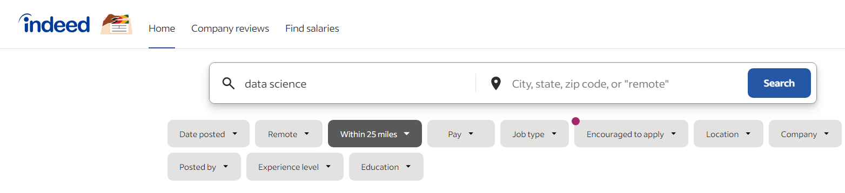


Slide 4
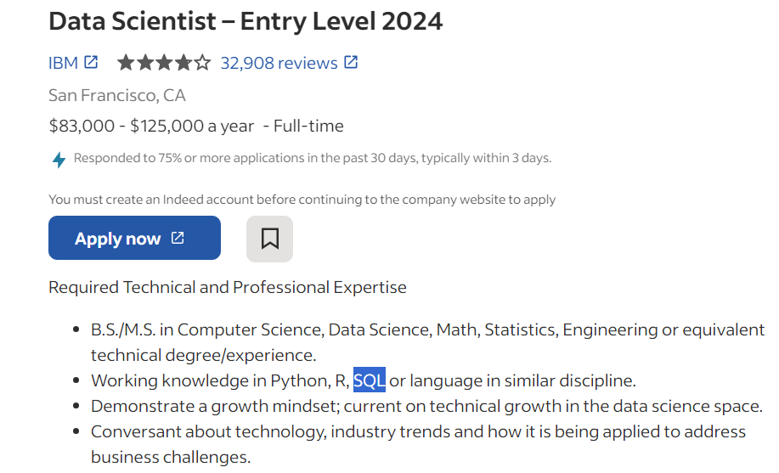

Slide 5
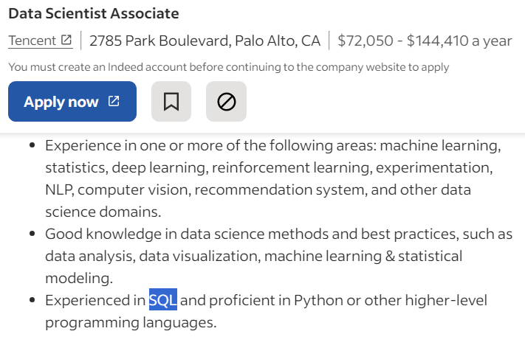

Slide 6
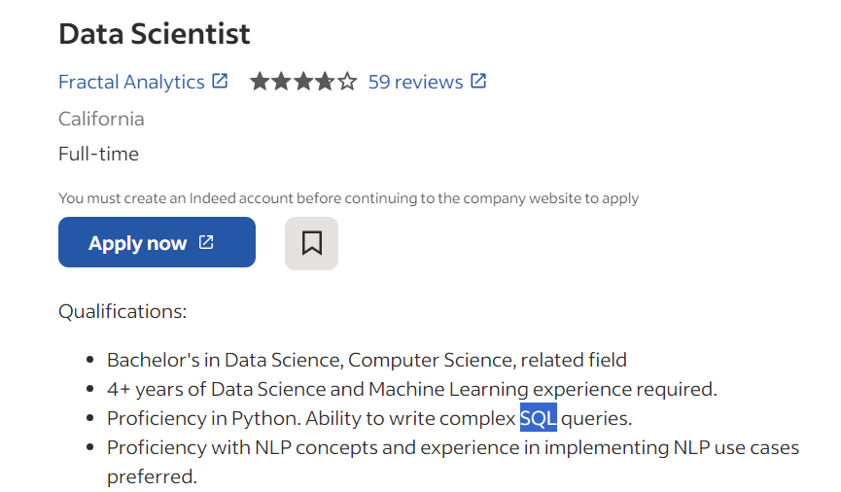

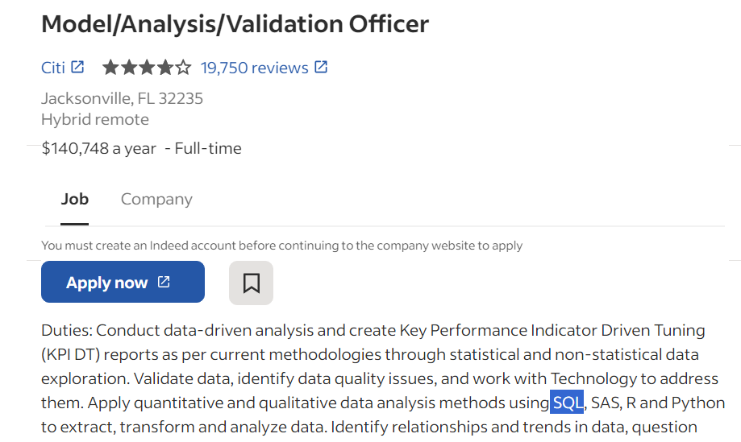
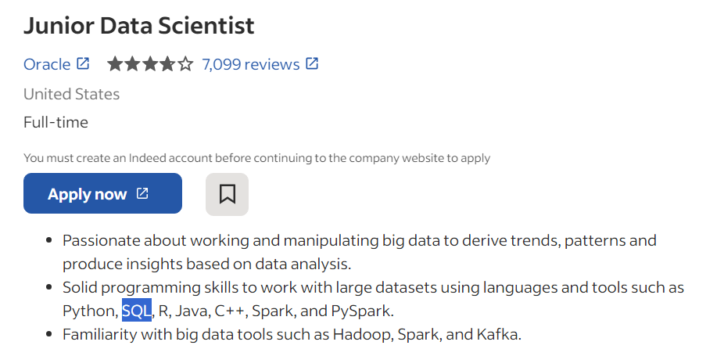
SQL SQL SQL SQL SQL

Slide 7

So, what is SQL?
SQL

Slide 8
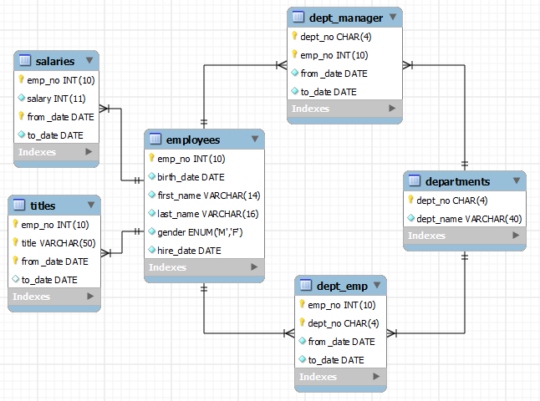
SQL and Databases
SQL → Structured Query Language
Programming language that lets us interact with databases
We can retrieve, remove, update, and store data easily with SQL
It is widely used and is easy to read
Notes:
Query language means that it has to do with specific procedure regarding databases and the information stored in them
So SQL is used to communicate with databases, it’s a pretty easy language to use in order to deal with them
Nisha
2 min

Slide 9
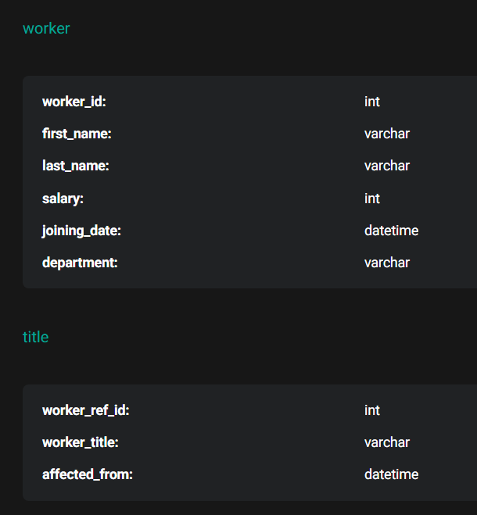
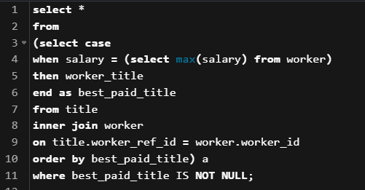
SQL Interview
What are the job titles of the highest paid employees?
Notes:
Query language means that it has to do with specific procedure regarding databases and the information stored in them
So SQL is used to communicate with databases, it’s a pretty easy language to use in order to deal with them
Nisha
2 min

Slide 10

On the job
Companies have a lot of data
They have teams working on analytics, modeling, visualizations, etc.
Weekly, monthly reports
Saves time, saves money
SQL gives you quick answers to
tough questions!
Notes:
Query language means that it has to do with specific procedure regarding databases and the information stored in them
So SQL is used to communicate with databases, it’s a pretty easy language to use in order to deal with them
Nisha
2 min

Slide 11


Previously on SQL part 1…
SELECT <column name(s)> FROM <table name>
WHERE <condition> (AND, OR, NOT)
GROUP BY <column name(s)>
HAVING <condition>
ORDER BY <column name(s)>
LIMIT <an integer>;
Notes:
Query language means that it has to do with specific procedure regarding databases and the information stored in them
So SQL is used to communicate with databases, it’s a pretty easy language to use in order to deal with them
Nisha
2 min

Slide 12
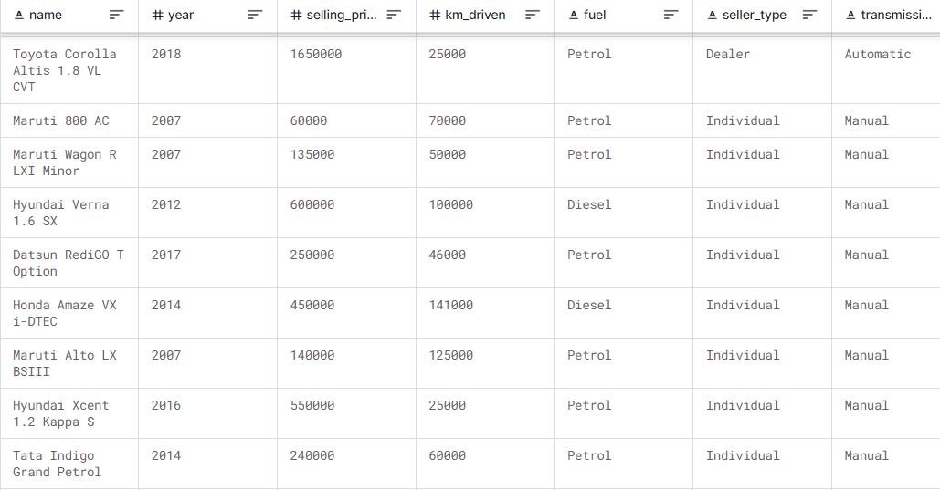
SELECT Statement
SELECT: What data you want to retrieve?
FROM: Which data table do you want to query from
SELECT name, year, km_driven
FROM used_cars;
If you want to select all columns,
SELECT * FROM used_cars;
used_cars
Notes:
Aditya
(4 mins)
General process: a cycle of going over a few concepts, showing some sample queries and then have yall do a few exercises on your own
Most basic SQL command: Select statement: used to fetch data from a database. Broken down into 2 key words:
Select: which data to select from a database.
From: specify which data table we want to query from.
Let’s go over some example queries.
-- SELECT Command --
-- SELECT * FROM tutorial.accounts; -- Selecting all cols/rows from the tutorial.accounts data table
-- SELECT id FROM tutorial.accounts; -- Select all rows from only the id column
-- Usage of aggregations! (Aggregation functions: calculation on a set of values, and returns a single summarized result (ex sum, avg, count))
-- SELECT COUNT(sales_rep_id) FROM tutorial.accounts; -- Count number of total non-null values in the sales_rep_id column (354)
-- Distinct returns one of each distinct value in the column
-- SELECT COUNT(DISTINCT(sales_rep_id)) FROM tutorial.accounts -- Count number of distinct/unique sales representatives (50)

Slide 13
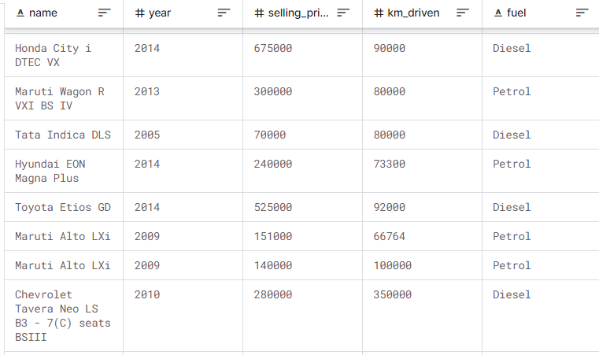
SELECT Statement
DISTINCT: Returns distinct/unique values of a column
What are all of the unique car models present in this dataset?
SELECT DISTINCT name
FROM used_cars;
used_cars
Notes:
Aditya
(4 mins)
General process: a cycle of going over a few concepts, showing some sample queries and then have yall do a few exercises on your own
Most basic SQL command: Select statement: used to fetch data from a database. Broken down into 2 key words:
Select: which data to select from a database.
From: specify which data table we want to query from.
Let’s go over some example queries.
-- SELECT Command --
-- SELECT * FROM tutorial.accounts; -- Selecting all cols/rows from the tutorial.accounts data table
-- SELECT id FROM tutorial.accounts; -- Select all rows from only the id column
-- Usage of aggregations! (Aggregation functions: calculation on a set of values, and returns a single summarized result (ex sum, avg, count))
-- SELECT COUNT(sales_rep_id) FROM tutorial.accounts; -- Count number of total non-null values in the sales_rep_id column (354)
-- Distinct returns one of each distinct value in the column
-- SELECT COUNT(DISTINCT(sales_rep_id)) FROM tutorial.accounts -- Count number of distinct/unique sales representatives (50)

Slide 14
ORDER BY Statement
ORDER BY: Sorts the rows by the selected column(s), can choose ascending or descending
If the column contains only numeric type values,
it will sort numerically! If it contains strings, it will sort alphabetically.
SELECT name, year, selling_price
FROM used_cars
ORDER BY selling_price ASC;
~ or ~
ORDER BY selling_price DESC;
used_cars
Notes:
Aditya
(4 mins)
General process: a cycle of going over a few concepts, showing some sample queries and then have yall do a few exercises on your own
Most basic SQL command: Select statement: used to fetch data from a database. Broken down into 2 key words:
Select: which data to select from a database.
From: specify which data table we want to query from.
Let’s go over some example queries.
-- SELECT Command --
-- SELECT * FROM tutorial.accounts; -- Selecting all cols/rows from the tutorial.accounts data table
-- SELECT id FROM tutorial.accounts; -- Select all rows from only the id column
-- Usage of aggregations! (Aggregation functions: calculation on a set of values, and returns a single summarized result (ex sum, avg, count))
-- SELECT COUNT(sales_rep_id) FROM tutorial.accounts; -- Count number of total non-null values in the sales_rep_id column (354)
-- Distinct returns one of each distinct value in the column
-- SELECT COUNT(DISTINCT(sales_rep_id)) FROM tutorial.accounts -- Count number of distinct/unique sales representatives (50)

Slide 15
GROUP BY Statement
used_cars
GROUP BY: Groups rows with the same values
AGGREGATE FUNCTIONS: count(), min(), max(), sum(), avg(), first(), last()
What were the average selling prices of used cars by year?
SELECT year, avg(selling_price)
FROM used_cars
GROUP BY year;
Notes:
Aditya
(4 mins)
General process: a cycle of going over a few concepts, showing some sample queries and then have yall do a few exercises on your own
Most basic SQL command: Select statement: used to fetch data from a database. Broken down into 2 key words:
Select: which data to select from a database.
From: specify which data table we want to query from.
Let’s go over some example queries.
-- SELECT Command --
-- SELECT * FROM tutorial.accounts; -- Selecting all cols/rows from the tutorial.accounts data table
-- SELECT id FROM tutorial.accounts; -- Select all rows from only the id column
-- Usage of aggregations! (Aggregation functions: calculation on a set of values, and returns a single summarized result (ex sum, avg, count))
-- SELECT COUNT(sales_rep_id) FROM tutorial.accounts; -- Count number of total non-null values in the sales_rep_id column (354)
-- Distinct returns one of each distinct value in the column
-- SELECT COUNT(DISTINCT(sales_rep_id)) FROM tutorial.accounts -- Count number of distinct/unique sales representatives (50)

Slide 16
WHERE Statement
used_cars
WHERE: Filters the rows by a given condition,
does NOT work with aggregate functions
Which cars are under 100,000km driven?
SELECT name, year, km_driven
FROM used_cars
WHERE km_driven < 100000;
Notes:
Aditya
(4 mins)
General process: a cycle of going over a few concepts, showing some sample queries and then have yall do a few exercises on your own
Most basic SQL command: Select statement: used to fetch data from a database. Broken down into 2 key words:
Select: which data to select from a database.
From: specify which data table we want to query from.
Let’s go over some example queries.
-- SELECT Command --
-- SELECT * FROM tutorial.accounts; -- Selecting all cols/rows from the tutorial.accounts data table
-- SELECT id FROM tutorial.accounts; -- Select all rows from only the id column
-- Usage of aggregations! (Aggregation functions: calculation on a set of values, and returns a single summarized result (ex sum, avg, count))
-- SELECT COUNT(sales_rep_id) FROM tutorial.accounts; -- Count number of total non-null values in the sales_rep_id column (354)
-- Distinct returns one of each distinct value in the column
-- SELECT COUNT(DISTINCT(sales_rep_id)) FROM tutorial.accounts -- Count number of distinct/unique sales representatives (50)

Slide 17
HAVING Statement
used_cars
HAVING: Filters the rows by a given condition,
it DOES work with aggregate functions
Cannot have HAVING without a GROUP BY
Which years have an average selling price greater than $20,000?
SELECT year, avg(selling_price)
FROM used_cars
GROUP BY year
HAVING avg(selling_price) > 20000;
Notes:
Aditya
(4 mins)
General process: a cycle of going over a few concepts, showing some sample queries and then have yall do a few exercises on your own
Most basic SQL command: Select statement: used to fetch data from a database. Broken down into 2 key words:
Select: which data to select from a database.
From: specify which data table we want to query from.
Let’s go over some example queries.
-- SELECT Command --
-- SELECT * FROM tutorial.accounts; -- Selecting all cols/rows from the tutorial.accounts data table
-- SELECT id FROM tutorial.accounts; -- Select all rows from only the id column
-- Usage of aggregations! (Aggregation functions: calculation on a set of values, and returns a single summarized result (ex sum, avg, count))
-- SELECT COUNT(sales_rep_id) FROM tutorial.accounts; -- Count number of total non-null values in the sales_rep_id column (354)
-- Distinct returns one of each distinct value in the column
-- SELECT COUNT(DISTINCT(sales_rep_id)) FROM tutorial.accounts -- Count number of distinct/unique sales representatives (50)

Slide 18
LIMIT Statement
LIMIT: Limits the number of rows outputted by the specified integer
What are the top 3 most expensive cars in this dataset?
SELECT name, year, selling_price
FROM used_cars
ORDER BY selling_price DESC
LIMIT 3;
used_cars
Notes:
Aditya
(4 mins)
General process: a cycle of going over a few concepts, showing some sample queries and then have yall do a few exercises on your own
Most basic SQL command: Select statement: used to fetch data from a database. Broken down into 2 key words:
Select: which data to select from a database.
From: specify which data table we want to query from.
Let’s go over some example queries.
-- SELECT Command --
-- SELECT * FROM tutorial.accounts; -- Selecting all cols/rows from the tutorial.accounts data table
-- SELECT id FROM tutorial.accounts; -- Select all rows from only the id column
-- Usage of aggregations! (Aggregation functions: calculation on a set of values, and returns a single summarized result (ex sum, avg, count))
-- SELECT COUNT(sales_rep_id) FROM tutorial.accounts; -- Count number of total non-null values in the sales_rep_id column (354)
-- Distinct returns one of each distinct value in the column
-- SELECT COUNT(DISTINCT(sales_rep_id)) FROM tutorial.accounts -- Count number of distinct/unique sales representatives (50)

Slide 19
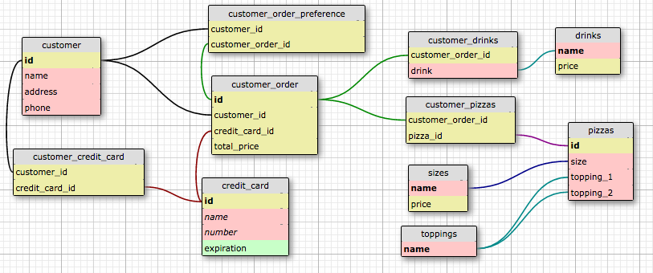

Slide 20
Joins
Retrieves data from two or more tables in one query
Very useful since relevant data is often contained in multiple tables
You need a column that is the same in both tables that you are trying to join (usually an ID, or some other key)
Four main types
General syntax:
SELECT * FROM table1 ____ JOIN table2 ON table1.ID = table2.ID;
Notes:
Joinssssss → kind of combining data from two tables
Useful if you have different tables with related data and want to have it all together
You need a key to join, basically it means have a column that is like an id with unique values so that we know what to join by
There are 4 more main types which we’ll go over in the next slide
Here we can see the join comes after the From statement and you have the original table, then specify what join you are doing
Then comes the second table name and finally what the key you are joining on

Slide 21
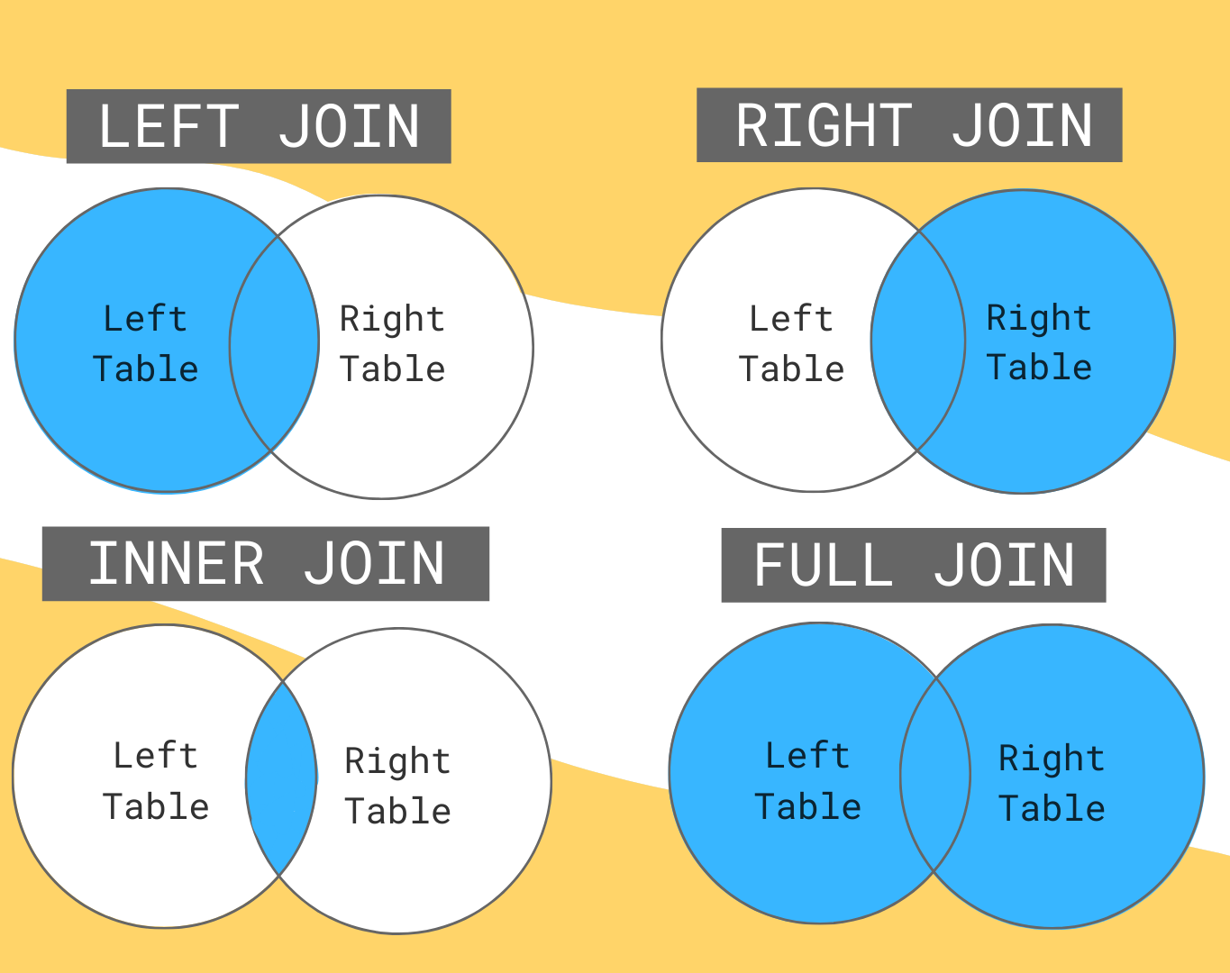
4 Types of Joins
Left Outer Join: Return all records from left table, and matched records from right table
Right Outer Join: Return all records from right table, and matched records from left table
Inner Join: Return records with matching values in both tables
Full Outer Join: Returns all records from both tables (matches on either left or right side)
Notes:
By default, JOIN by itself refers to an INNER JOIN
Also there are inclusive and exclusive joins, we are just talking about the inclusive joins today, but basically exclusive omits the data that matches
So for LEFT JOIN, RIGHT JOINs and inclusive FULL JOINs:
If there is no matching row from the tables: there will be NULL instead

Slide 22
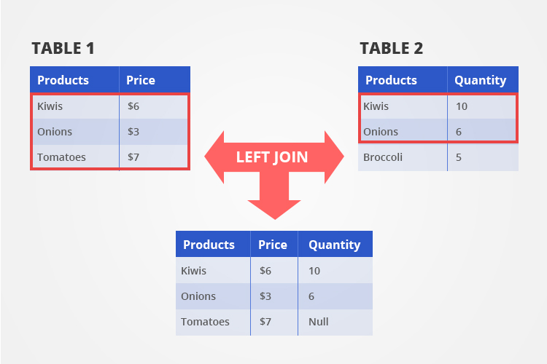
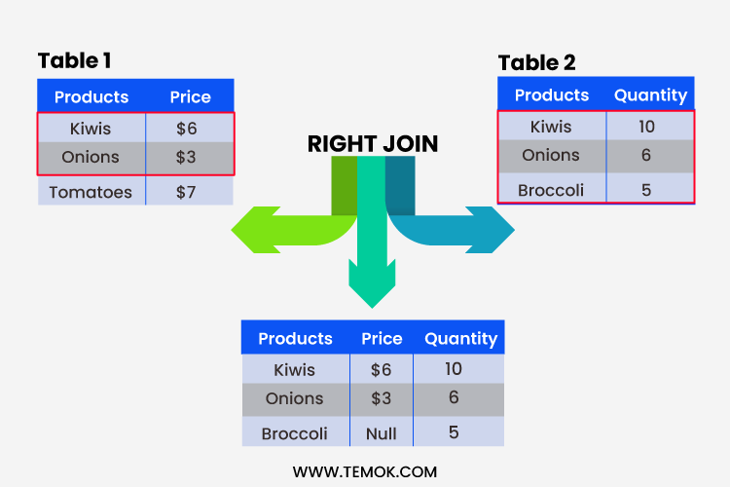
Joins (Examples)
SELECT * FROM Table1
LEFT JOIN Table2
ON Table1.Products = Table2.Products;
SELECT * FROM Table1
RIGHT JOIN Table2
ON Table1.Products = Table2.Products;
Notes:
Left join →
So our table 1 is the left table and table 2 is the right table in this case, so selecting from a table makes that the left table.
We’re then joining table two on the key: products from both the tables.
So we see we keep everything from table 1 since its the left table and whatever rows match up with the ids in table 1 from table two we join. So only kiwis and onions from table 2 match table 1 so those are the only rows that join. Since we had no match for tomatoes so the quantity is null
For right join, it's the same concept but now we are looking at the right table (table 2). So whatever matches up from table 1 will join to table 2, again kiwis and onions. But here we dont have a match for broccoli so the price is null

Slide 23
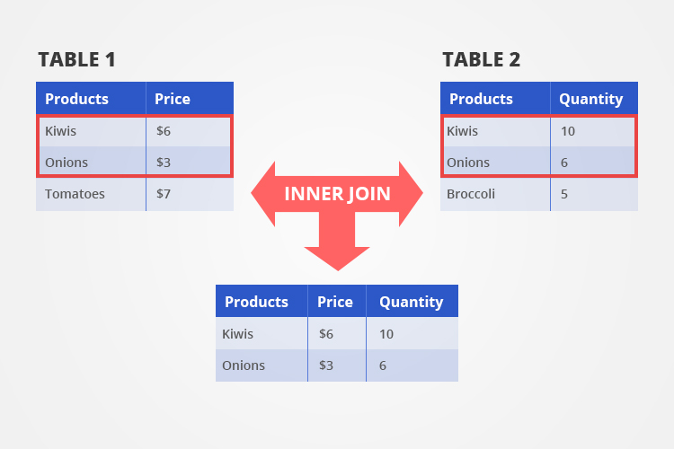
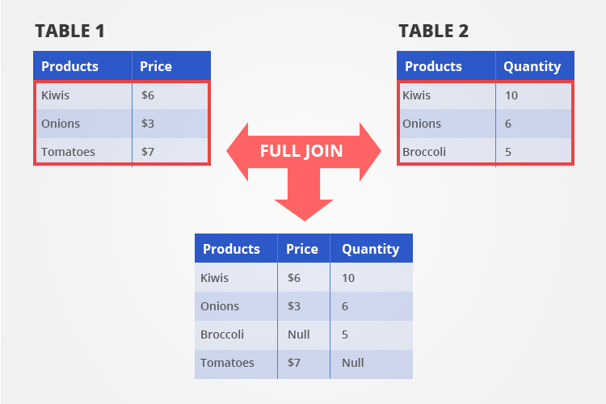
Joins (Examples)
SELECT * FROM Table1
(INNER) JOIN Table2
ON Table1.Products = Table2.Products;
SELECT * FROM Table1
FULL JOIN Table2 ON Table1.Products = Table2.Products;
Notes:
Now we have inner join → this is what matches in both tables, so only kiwis and onions, everything else we get rid of
note : Should be no NULL records in a Inner Join because it's solely where the ids match up, so there won’t be any missing data
Finally full join:
Everything from both tables joins together and we will have nulls if there are rows that dont have a match
Kiwis, onions, broccoli, and tomatoes

Slide 24
Joins
When joining, you want to specify the table name before the column names, separated by a period (.)
SELECT table1.products, table1.price, table2.quantity FROM table1 INNER JOIN table2 ON table1.products = table2.products;
General tip: You can use AS to rename your tables within the code (helpful for joins since you will refer to the table names frequently)
SELECT t1.products FROM table1 AS t1;
Notes:
Since we are using 2 tables, want to make it clear which columns we are referring to
Also if the two tables have the exact same column name
table1 as t1, table2 as t2, this way it is easier when you refer to them later in your code, you can do this with the column names too

Slide 25

Exercise 1 - Joins
The table animal_crossing_villagers contains data on the villagers in Animal Crossing (name, personality traits, house types)
The table animal_crossing_wallpaper contains data on the types of wallpapers in Animal Crossing (buy price, sell price, colors, etc.)
Using the above tables, return a table that contains the names of ALL the villagers in Animal Crossing, their species, the type of wallpaper they have, and the buy and sell prices of their wallpaper.
Hints: What type of join is this if we want to keep ALL the villagers in our result table? What is the common column in the two tables?
Check: Your result should have 5 columns.
Notes:
Notes: Typically best practice to join on something like a unique numerical ID, since you can always have an issue of things being entered slightly diff in diff tables
Even extra spaces, hyphens, etc. will throw it off since JOINs look for EXACT matches
But here, we can assume that the way wallpaper name was entered in both tables is exactly the same :)

Slide 26
Exercise 1 - Solutions
SELECT villagers.name, villagers.species, villagers.wallpaper, wallpaper.buy, wallpaper.sell
FROM tutorial.animal_crossing_villagers AS villagers
LEFT JOIN tutorial.animal_crossing_wallpaper AS wallpaper
ON villagers.wallpaper = wallpaper.name
Note: Renamed the source tables using the AS operator so that code is slightly clearer!
Notes:
Selecting cols name, species, and wallpaper from the villagers data set and then buy, sell columns from the wallpaper data set.
Since we want all the names which is in our villager data set and just adding the buy and sell information, we can do a left join where villagers is the left table
And wallpaper is the right
Then we join on our key wallpaper

Slide 27
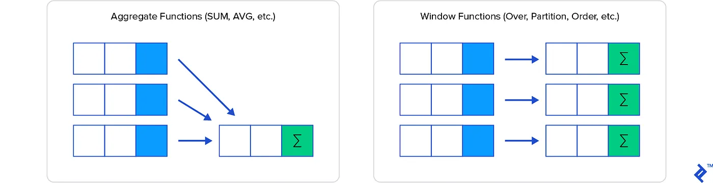
Analytic Functions
Return values for each row based on a certain group of rows (as compared to regular aggregate functions covered in the past)
Defining characteristic: the over clause
3 Types:
Aggregate functions
Navigation functions
Numbering functions
Notes:
Analytic functions allow us to perform complex calculations with relatively straightforward syntax. For instance, we can quickly calculate moving averages and running totals, among other quantities. There are 3 types of these, which we’ll go into further detail later. First, let’s focus on how this is written and what makes an analytic function an analytic function, the over clause.
Brief overview of what they are + common syntaxn (introduce window frame clauses here)
https://app.mode.com/editor/ddsc21/reports/418cd5823ed0/queries/90bceb1a42fc

Slide 28
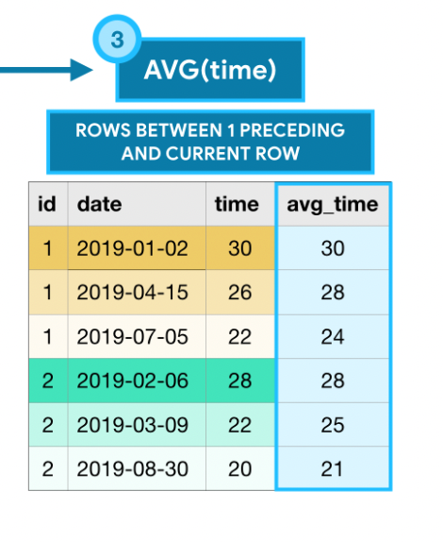
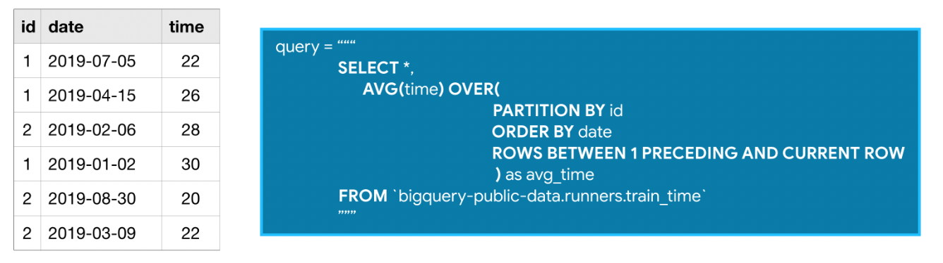
Over Clause
All analytic functions have over clauses -> to define the rows used for the calculations
3 optional parts: PARTITION BY (divides the rows into groups), ORDER BY (defines an ordering w/in the partitioning), and the window frame clause (identifies set of rows used)
Notes:
The defining feature of an analytic function is the over clause and the window frame clause. The over clause is the part that allows you to define which rows will be used in your query’s calculation. The over clause has three optional parts. PARTITION BY divides the rows into separate groups. In this example here, the table has data from two people that training for a race. So, using PARTITION BY on the id column separates the calculations by each runner. The ORDER BY clause creates order within the partition. So, ordering by date makes sure that the earlier training sessions are shown first. The line below ORDER BY is called the windowframe clause. This is the part that actually identifies the group of rows used in our calculation, which are called the window. Here the window frame clause is “ROWS BETWEEN 1 PRECEDING AND CURRENT ROW” which means the previous and the current row. EXPLAIN THE TABLE ON THE RIGHT
ROWS BETWEEN 3 PRECEDING AND 1 FOLLOWING: the 3 previous, the current, and 1 after
ROWS BETWEEN UNBOUNDED PRECEDING AND UNBOUNDED FOLLOWING: means all rows in the partition
https://app.mode.com/editor/ddsc21/reports/418cd5823ed0/queries/90bceb1a42fc

Slide 29
3 Types
1.
2.
3.
Analytic Aggregate functions
Analytic Navigation Functions
Analytic Numbering Functions
Regular aggregate functions = 1 calculation returned
Analytic aggregate functions = 1 per row selected by the over clause
Return a value to each row that is usually from another row than the current
Return values based on order to each row
MIN() or MAX()
AVG()
SUM()
COUNT()
FIRST_VALUE() or LAST_VALUE()
LEAD() or LAG()
ROW_NUMBER()
RANK()
Notes:
Now that we know how to formulate a query for analytic functions, let’s go into the specifics of the different types. Analytic aggregate functions take all the values in the window and return a value for it. I’m sure min, max, avg, and sum are familiar to you guys as the name describes it. The count function tells you the number of rows in that window. Analytic navigation functions usually assign a value to each row that is from another row than the current. For example, first value returns the first value in the input. Lead and lag returns the value on a subsequent or preceding row. Analytic numbering functions assign integer values to each row based on the ordering. Row number returns the order in which rows appear in the input (starting with 1). For the rank function, All rows with the same value in the ordering column receive the same rank value, where the next row receives a rank value which increments by the number of rows with the previous rank value.

Slide 30
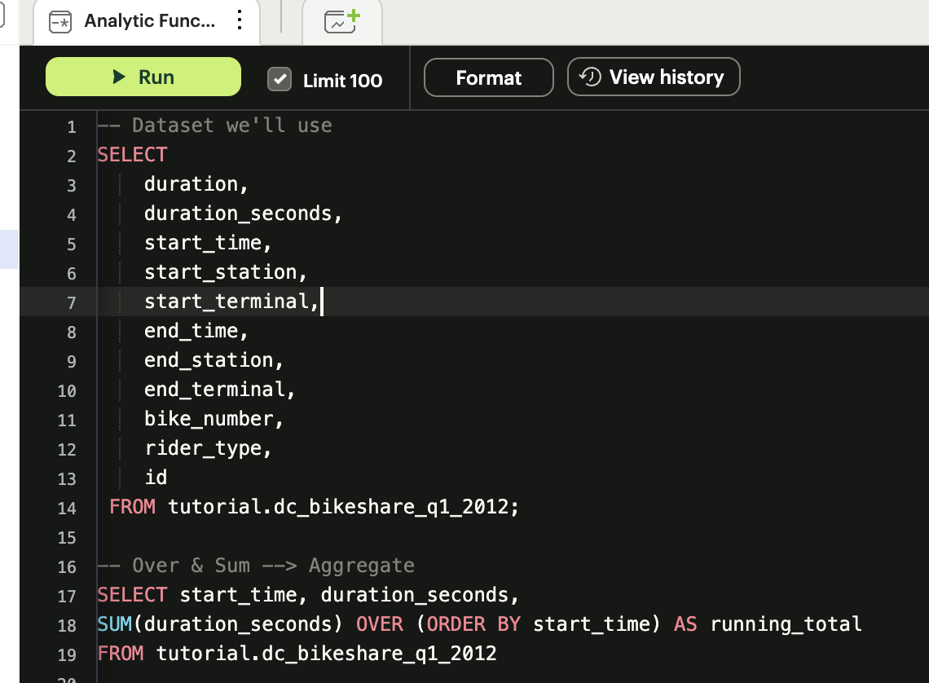
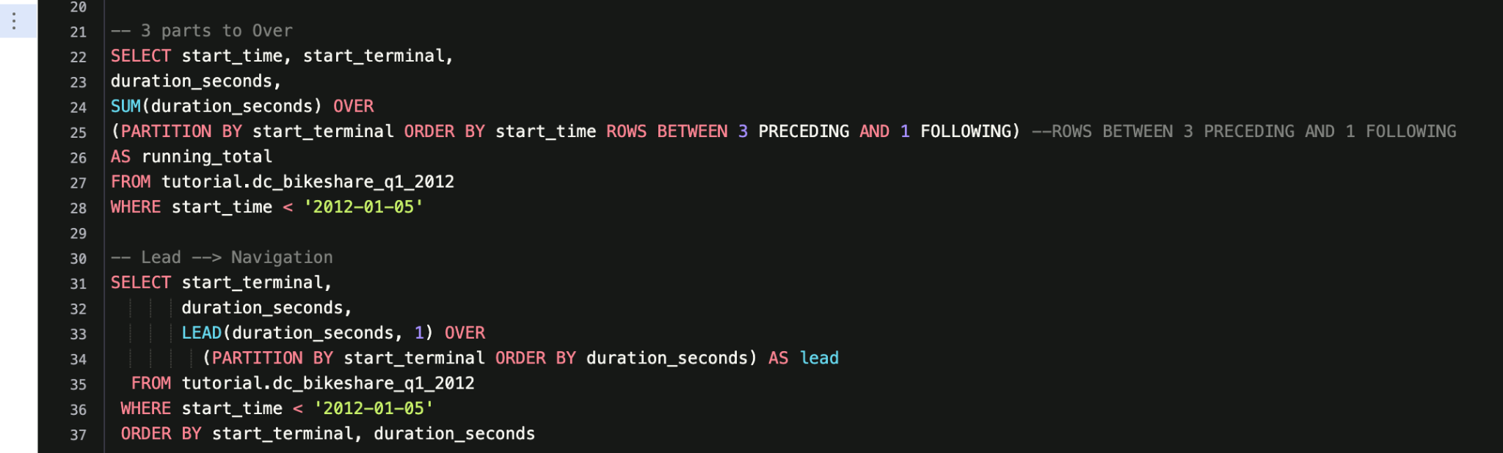
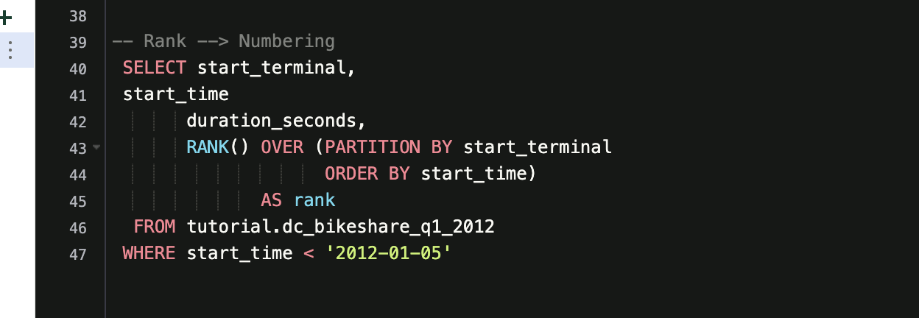
Analytic Functions Example Code

Slide 31
Exercise 2 - Analytic Functions
Dataset used → tutorial.dc_bikeshare_q1_2012
Limit to rides that occurred before Jan. 5, 2012
Write a query that shows a running average of the duration of bike rides, but grouped by end_terminal
Write a query using the LAG() function to the calculate the difference of duration seconds between rows
Tougher Question:
Write a query that shows the 5 longest rides from each starting terminal, ordered by terminal, and longest to shortest rides within each terminal.
Notes:
Aggregate funcs. - where multiple values are processed together to form a single summary statistic.
https://app.mode.com/editor/ddsc21/reports/418cd5823ed0/queries/90bceb1a42fc
https://mode.com/sql-tutorial/sql-window-functions#defining-a-window-alias
https://www.kaggle.com/code/alexisbcook/analytic-functions

Slide 32
Exercise 2 - Solutions
SELECT end_terminal,
duration_seconds,
AVG(duration_seconds) OVER
(PARTITION BY end_terminal ORDER BY duration_seconds)
AS running_avg
FROM tutorial.dc_bikeshare_q1_2012
WHERE start_time < '2012-01-05'
SELECT start_terminal,
duration_seconds,
duration_seconds -LAG(duration_seconds, 1) OVER
(PARTITION BY start_terminal ORDER BY duration_seconds)
AS difference
FROM tutorial.dc_bikeshare_q1_2012
WHERE start_time < '2012-01-05'
SELECT *
FROM (
SELECT start_terminal,
start_time,
duration_seconds,
RANK() OVER (PARTITION BY start_terminal ORDER BY duration_seconds DESC) AS rank_order
FROM tutorial.dc_bikeshare_q1_2012
WHERE start_time < '2012-01-05'
) temp
WHERE temp.rank_order <= 5
Notes:
Here instead of sum it’s average and the partition is end_terminal instead
We want to calculate the difference between the current row and previous row so we do a new col as duration second - lag()
Okay first we wanna rank, and since we want the 5 longest rides we have to rank the duration in descending order. Now that we ranked them if we only want the top 5 we have to select from this data that we just created. So we can create a temporary table by putting it in a from statement and writing a name next to it, in this case we call it temp. Then we select everything from it (asterisk) and filter is by saying we want the rank to be less then or equal to 5 from the temp tables

Slide 33
Resources
SQL Police Game (Practice SQL with a fun detective game!) - https://sqlpd.com/
SQL Interview questions - https://platform.stratascratch.com/coding?code_type=1
Kaggle Advanced SQL Course - https://www.kaggle.com/learn/advanced-sql
SQL Joins Tutorial - https://www.w3schools.com/sql/sql_join.asp
Oracle Analytic Functions - https://docs.oracle.com/en/database/oracle/oracle-database/19/sqlrf/Analytic-Functions.html#GUID-527832F7-63C0-4445-8C16-307FA5084056

Slide 34


Thank you!
IG: @data.ucd
FB: facebook.com/data.ucd
Website: davisdsc.com
GitHub: Davis-Data-Science-Club
Discord: discord.gg/zCPRKHdM7
Linktree: linktr.ee/davisdsc
Notes:
QR code in case ppl need to sign in
https://linktr.ee/davisdsc
https://discord.gg/zCPRKHdM7
www.davisdsc.com
www.facebook.com/data.ucd

